Slide 1
Causal Analytics “Econometric model in NPS”
TEAM MEMBERS Dania Crivelli A20071614
Rhoda Alawiye A20392590

Slide 2
Table of contents
Causal Analytics “Econometrics” model in NPS Categories
Business Understanding/Problem statement
CRISP-DM Model
Methodology
Data Cleaning
Data Preparation
Regression Model Specification
Modeling
Analysis results
Conclusions

Slide 3


Our team
Dania Crivelli
1st year MsBanDS student
Rhoda Alawiye
1st year MsBanDS student

Slide 4
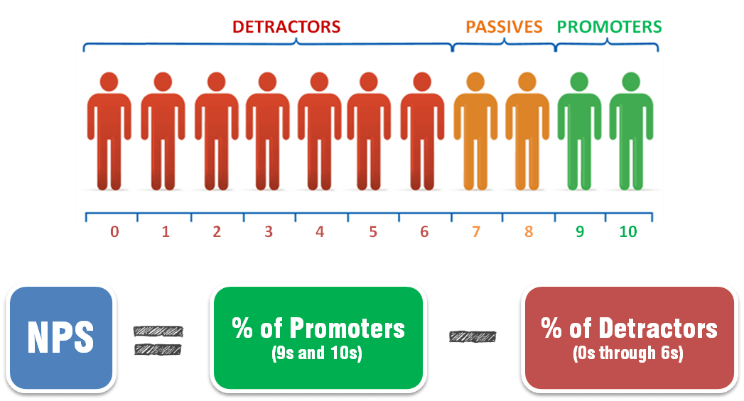
A. Business Understanding
What happens to the probability to promote when a promoter topic is increased by 10% and a detractor topic is reduced by 10%?

Slide 5
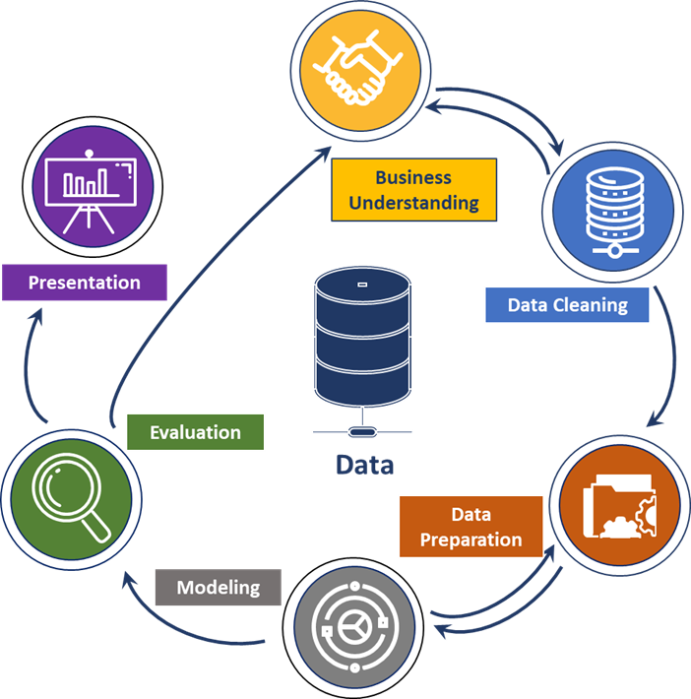
CRISP-DM MODEL
We followed the CRISP-DM Model, which is a methodology followed for the data mining processes.

Slide 6
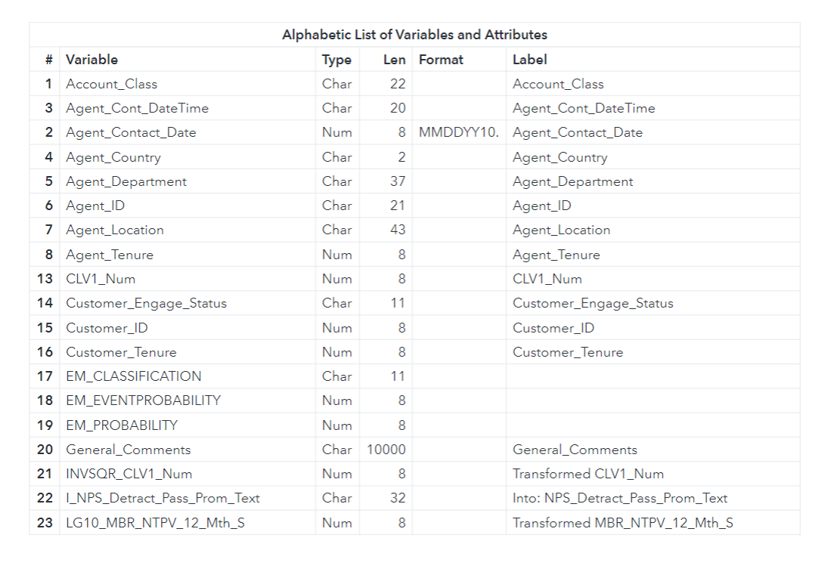
DATA DICTIONARY
Data summary:
72900 observations
Total 42 variables
12 string variables
30 integer variables

Slide 7
Methodology
1
Steps followed in our analysis

Slide 8
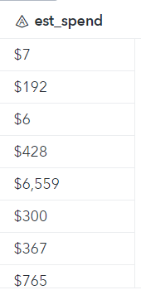
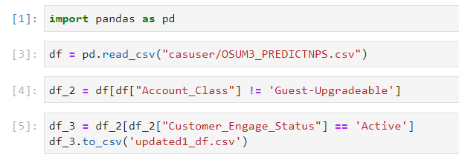
B. Data Cleaning
The format for the est_spend variable was changed because it has a dollar sign which made it appear as a character variable.
The first step we took in the analysis was to first subset the data to only include “Active” customers in the “Customer_engage_status” variable as well as removing any “Guest-Upgradable” observations in the “Account_Class” variable.

Slide 9
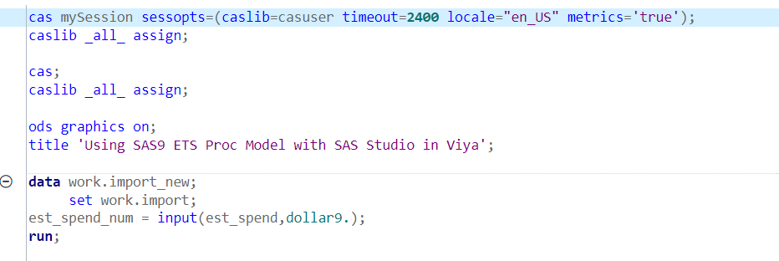
B2. Data Cleaning
This is the code we used to change the format of the string to integer for Est_spend variable

Slide 10
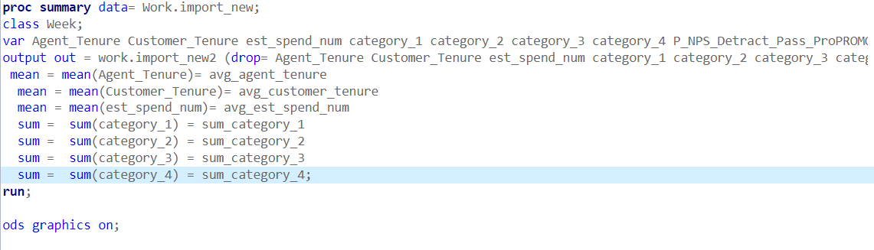
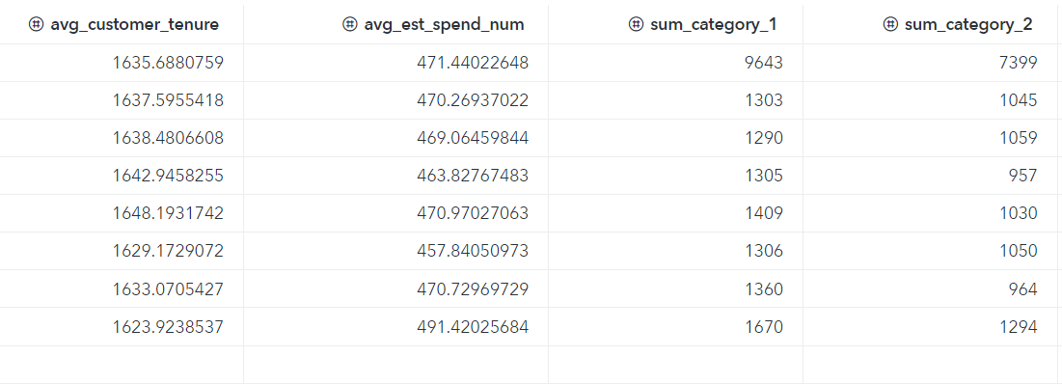
C. Data Preparation
Overall, these steps helps to provide a more manageable and condensed data set for the analysis while still retaining the necessary information for the 7-weeks data.
Proc Summary was used in the analysis to aggregate the data by weeks and compute summary statistics for the variables of interest.
The “var” statement specifies the summarized variables.
The mean statement was used to compute the average values of each interval variables and the sum statement computes the sum of each of the four categorical variable.

Slide 11
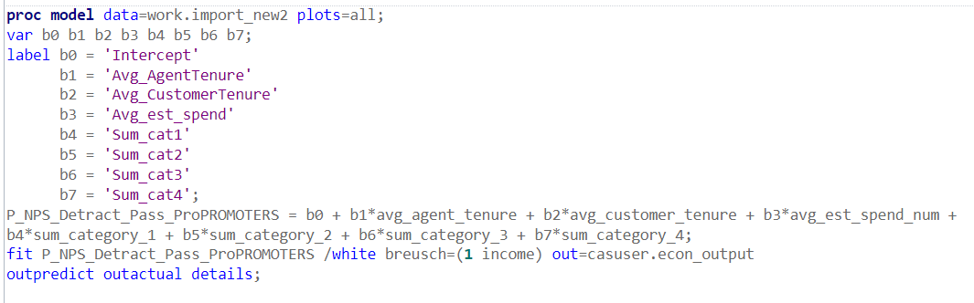
C2. Regression Model Specification
Proc Model is used to specify the linear regression model to predict the probability of being a promoter based on the variables of interest.
The “var” statement specifies the variables to be included in the model which are the intercepts with the interval and categorical variables.
The “label” statement is used for the purpose of easier interpretation of results.
The regression equation is used to specify how the predictor variables are combined to predict the target variable(P_NPS_Detract_Pass_ProPROMOTERS).
This helps to understand the relationship between the predictor variables and the response variables which will enable us to identify the variables that are of the most importance in predicting the target/response variable.

Slide 12
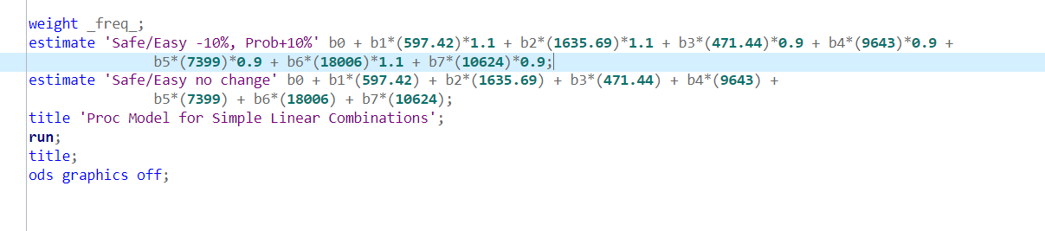
D. Modeling
The estimate statement is used to estimate the predicted value of the target variable.
The first “estimate” statement tests what happens to the probability to promote when a promoter topic is increased by 10% while the detractor topic is reduced by 10%.
The second “estimate” statements tests what happens to the probability to promote when no changes are made to the variables in the model.
These are to help understand how the changes in the independent variables affect the predicted variable.

Slide 13
Analysis Results

Slide 14
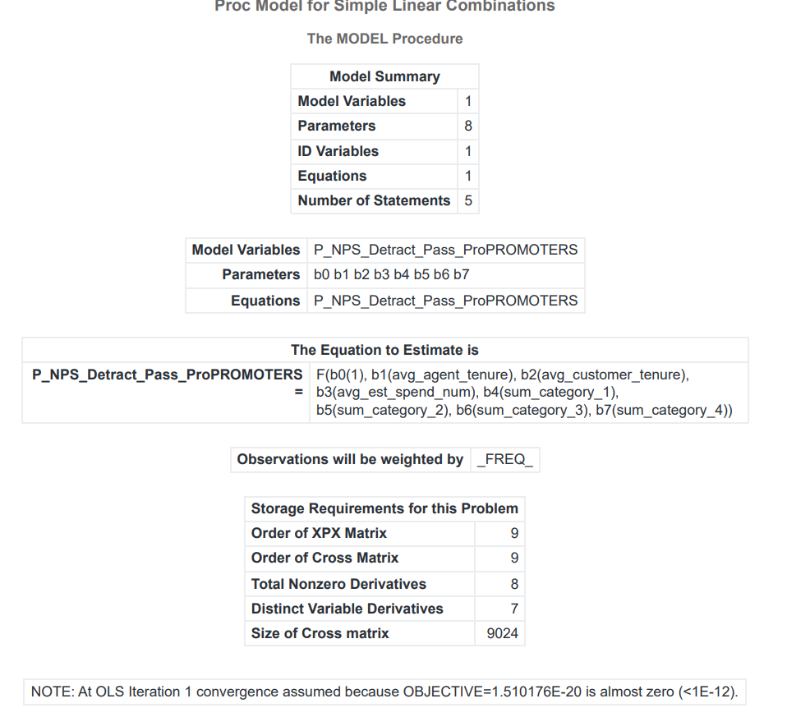
Analysis Result 1
The linear combination in which each independent variable is multiplied by its respective parameter and then added to the intercept parameter.
The OLS(Ordinary Least Squared) algorithm shores that the objective function converges at the first iteration because it was very close to zero.

Slide 15
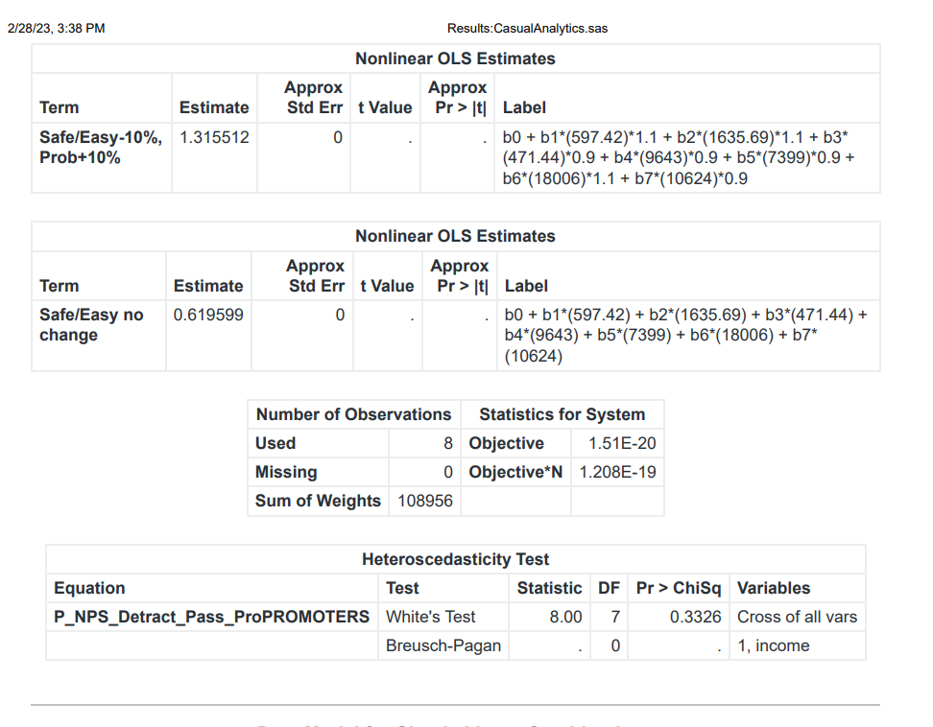
Analysis Result 2
The first “estimate” statement that tests what happens to the probability to promote when a promoter topic is increased by 10% while the detractor topic is reduced by 10% is 1.315512.
The second “estimate” statements that tests for what happens to the probability to promote when no changes are made to the variables in the model is 0.619599.
The White’s test had a value of 0.3326 for the Pr > ChiSq at 7 DF across all variables and the Breusch-pagan test was null for the test of heteroscedasticity.
This suggests that there is no significant evidence of heteroscedasticity in the model.

Slide 16
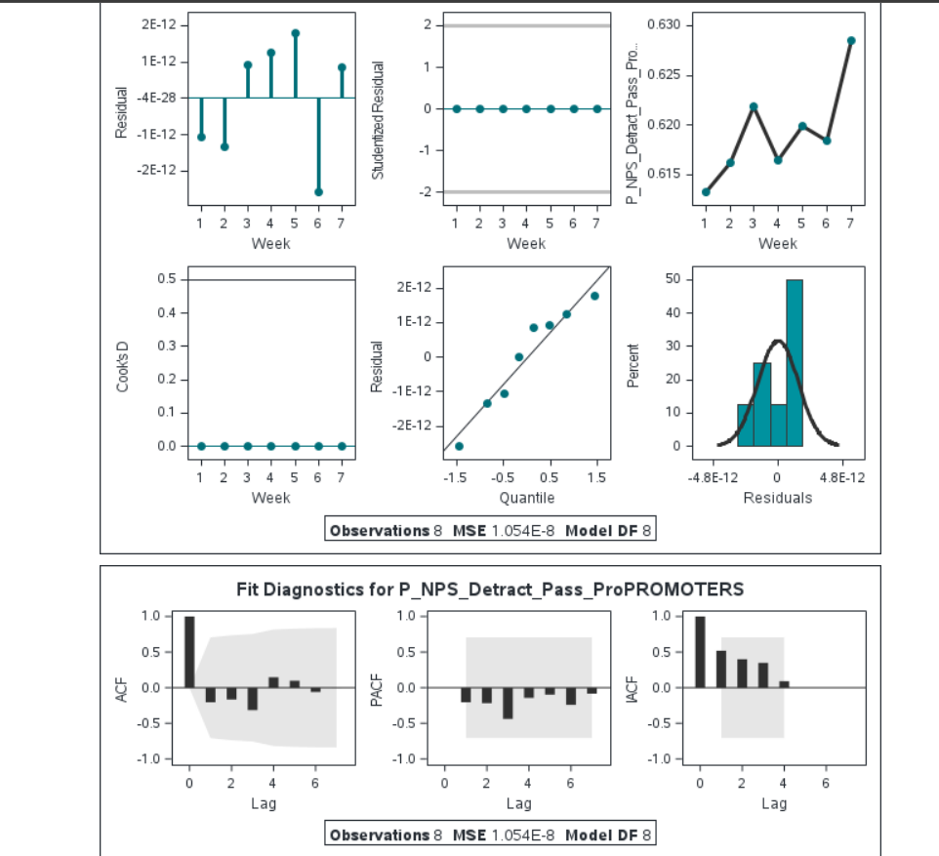
Analysis Result 3
The fit diagnostics report for the target variable P_NPS_Detract_Pass_ProPROMOTERS showing the Residual plot, Studentized residual, Cook’s D and the quantile plot which are used to test for the linearity, normality and heteroscedasticity of errors of the regression model.
The fit diagnostics report for the target variable P_NPS_Detract_Pass_ProPROMOTERS also show the ACF(Autocorrelation function) which is used to test for the autocorrelation, PACF(Partial Autocorrelation function) used to measure the correlation between a time series and its lagged values after removing the effects of intermediate lags and WCF(Wavelet Coherent Function) used to measure the correlation between two time series across different frequencies.

Slide 17
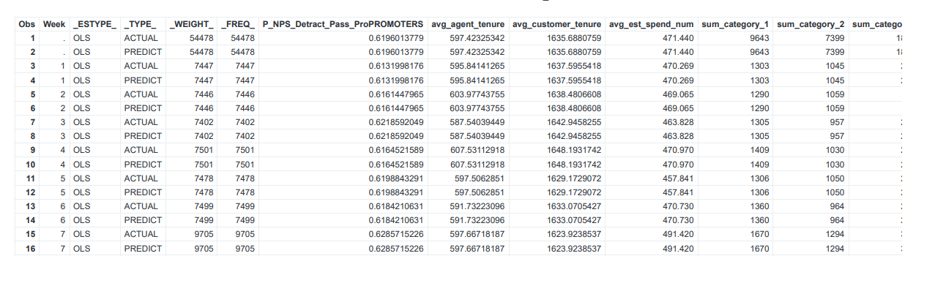
Analysis Result 4
This shows the OLS results of the actual and predicted values for each of the variables of the regression model for the 7-weeks.

Slide 18


Conclusion
Safe/Easy -10%/Prob+10%
The probability to promote when changes are made to the promoter topic and the detractor topic is 31.55%.
Safe/Easy no change
The probability to promote when no changes are made to the variables in the model is 6.19%

Slide 19

THANK YOU !

